Slide 1
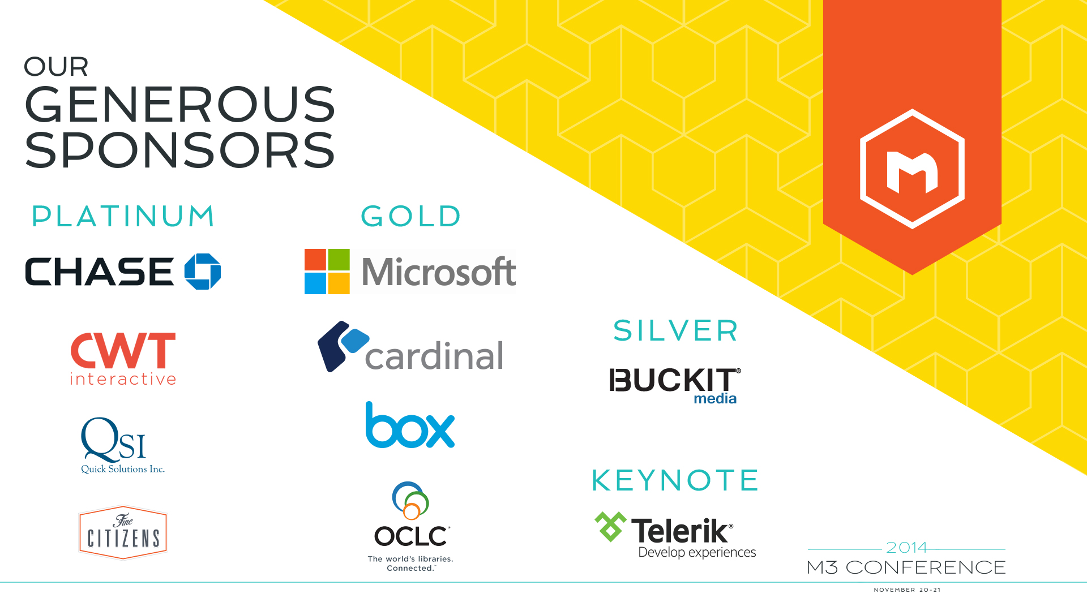

Slide 2
BYOD: Securing LOB Applications on Personal Devices
Michael Meadows
@AntiArchitect
Notes:
----- Meeting Notes (7/10/13 10:50) -----
Change to mobile

Slide 3
Concepts

Slide 4

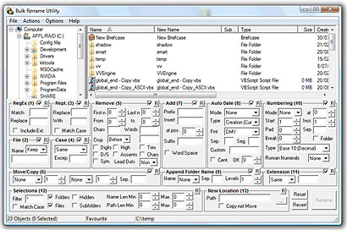
The Security World As Built By Application Developers
Focus on Functionality
Ignore Non-Functional Requirements (Security)
User Experience Over Security
Lots of Data (Developers Love Data)

Slide 5

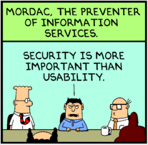
The World As Imagined By Security Architects
Focus on Vulnerability
Secure Everything
Allow Nothing
Security Over Productivity

Slide 6
Threat Modeling
Asset – A resource of value, such as the data in a database or on the file system. A system resource.
Threat – A potential occurrence, malicious or otherwise, that might damage or compromise your assets.
Vulnerability – A weakness in some aspect or feature of a system that makes a threat possible. Vulnerabilities might exist at the network, host, or application levels.
Attack (or exploit) – An action taken by someone or something that harms an asset. This could be someone following through on a threat or exploiting a vulnerability.
Countermeasure – A safeguard that addresses a threat and mitigates risk.
http://msdn.microsoft.com/en-us/library/ff648644.aspx

Slide 7
Assets
What They Can Get
User or Client Data
Personally Identifiable Information
Financial Information
Corporate Data
Accounts
Proprietary Information
Intellectual Property
What They Can Do
Malicious Acts
Access Network
Direct the System to Undesired Results

Slide 8
Threats
In addition to normal threats, BYOD adds:
Device Theft
Insecure Use of Local Storage
Unsecured WiFi
Malicious Applications
Rating threats using DREAD
Damage Potential
Reproducibility
Exploitability
Affected Users
Discoverability
High (3), Medium (2), Low (1)
Score Each Threat on Each DREAD Criterion
Prioritize Based on Risk

Slide 9

Understanding Layers
Network
Host
Application
Device

Slide 10
Vulnerabilities
Vulnerabilities Are Realizations (Instances) of Threats
BYOD Introduces More Surface Area (Device)
High Surface Area
Public Facing APIs
Alternative Authentication Methods
Unencrypted Devices

Slide 11
Attacks
In addition to conventional attacks
Public WiFi
Snooping
Compromised Devices
Malicious Hotspots
Device Theft
Local Storage Access
Application Access
API Hacks
Port Scanning
DDoS
Unauthorized Access

Slide 12

Countermeasures

Slide 13
Tools
Techniques, Countermeasures, and Things to Consider

Slide 14
Don’t Overdo It
Passwords
Typing passwords on phones is hard
Users are lazy
The harder it is to remember or type, the more likely it is that users will write it down or keep it in their notes
VPN
Bypasses good security practices for the sake of application development simplicity
Configuration Complexity
Overly Restrictive Device Management Policies
“Just Right” for the threat profile
Biometrics
Fingerprint
Face Recognition
Notes:
Daily Mail: Average person checks phone 110 times a day… up to every 6 seconds in the evening.

Slide 15
Mobile Device Management (MDM)
Allows applications to declare “policies” which must be fulfilled before using the application.
Android: Device Administration API (http://developer.android.com/training/enterprise/device-management-policy.html)
iOS: Mobile Device Management Framework (http://www.apple.com/ipad/business/it/management.html)
3rd Party
AirWatch (http://www.air-watch.com/solutions/mobile-device-management)
AppTec (http://www.apptec360.com/en_home.html)
Bushel (http://www.bushel.com/)
Casper Suite (http://www.jamfsoftware.com/)
Yosemite Profile Manager (http://krypted.com/mac-security/configure-profile-manager-on-yosemite-server-yosemite-running-the-server-app/)
MobileIron (https://www.mobileiron.com/en)
Notes:
Introduced in Android 2.2

Slide 16
Multi Factor Authentication
RSA Keys
Security Questions
Automated Phone Authentication
Voice Authentication
SMS/MMS
Local Storage
Don’t store any important data on devices
If you must store important data on devices, encrypt it
Don’t use local storage as cache
Do use local storage for data that is not valuable

Slide 17
Least Privilege
Design your application assuming only the most basic authorization by default
Users are granted access to the specific functions required for their job duties
In Addition
Segregate permanent and temporary authorization
Permanent authorization should only be granted for low risk functions
Users must elevate claims to access sensitive data on a per-record basis
System issues claims per record
System can throttle access in order to prevent automated data theft
Log access
Notes:
If short on time, explain authz, authc, and claims

Slide 18
Use Approval Workflows
Workflows provide a clear audit history
Can be designed to be reversible
Rank your user actions by risk
Low risk actions can execute immediately
Medium risk actions should move through automated workflows
High risk actions should require human approval

Slide 19
Tips
Assume your system will be compromised
Reality is that even the most “security minded” companies get hacked.
Eliminate exploits when you can, but mitigate those that you can’t.
Prioritize threats (you can’t address them all).
Minimize your exposure (surface area) by providing users with only what they need.
Automate decision making whenever possible in order to reduce data exposed to users.
Assume people, not the device is your largest vulnerability
Acknowledge user behaviors you can’t change; mitigate behaviors that you can’t prevent.
Users are guaranteed to not care as much about security as you do.
Design your application to encourage, not expect, good behavior.
Balance tradeoffs between security and productivity.

Slide 20
Thank You
Michael Meadows: @AntiArchitect

